Slide 1




Impact of the Whole Family Approach on Working Families
October 27, 2020

Slide 2
Welcome – Fran Sykes
The Senator Walter Rand Institute for Public Affairs’ Evaluation of the Whole Family Approach
– Ross Whiting, Ph.D.
COVID Impacts, Supporting Collaboratives
A qualitative evaluation of collaboratives’ work with the Whole Family Approach during the COVID-19 pandemic – Ross Whiting, Ph.D.
Q & A
The University of Pennsylvania School of Social Policy & Practice’s Economic Mobility and Strengthening Working Families Whole Family Approach Evaluation
– Amy Castro Baker, Ph.D., MSW
COVID-19 Whole Family Approach Impact Research
– Amy Castro Baker, Ph.D., MSW
Q & A
Wrap-up

Slide 3
Pascale Sykes Whole Family Approach
focuses on working families trying to get ahead;
the approach is prevention, not crisis oriented.
Whole people within whole families
At least 2 adults in charge, all family members involved
Family and individual plans with all family members working together; informal supports
Long range plans with behavior goals; SMART behavior objectives (outcomes, indicators); dig for roots
Agencies working together; shared information
All agencies involved in data collection, data evaluation and reformatting of a) individual family plans and b) entire effort

Slide 4
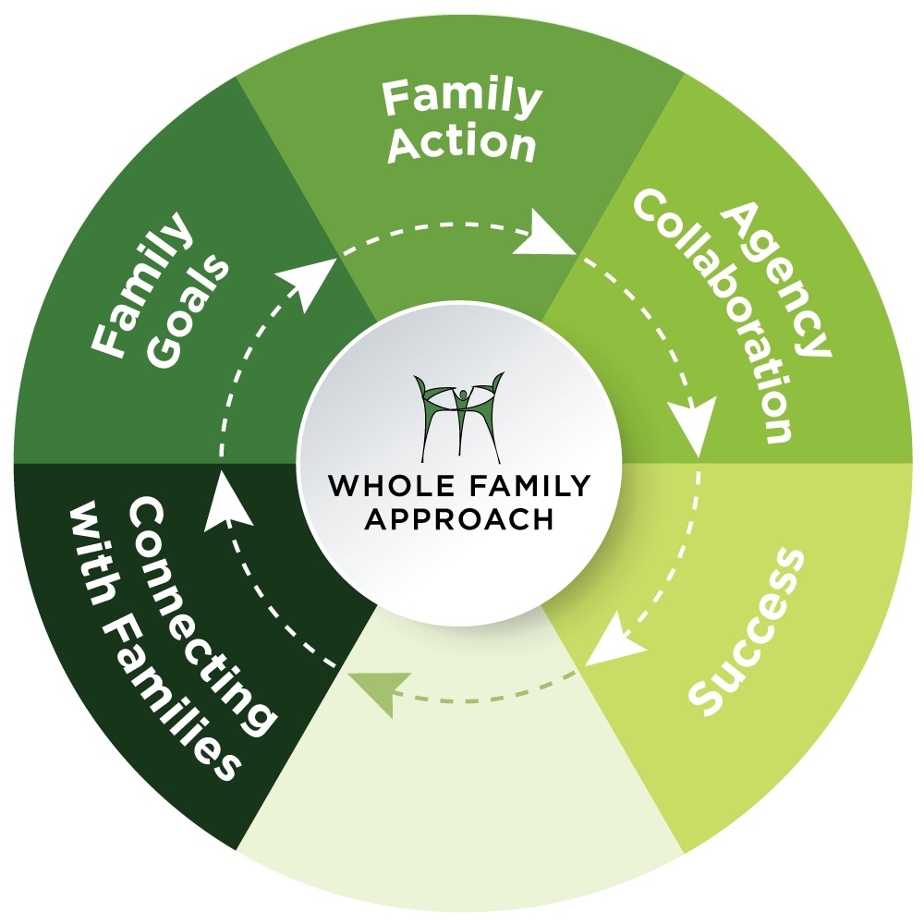

Strategy
Steps

Slide 5
Strategy
Steps

Slide 6
Strategy
Steps

Slide 7
Strategy
Steps

Slide 8
Strategy
Steps

Slide 9
Strategy
Steps

Slide 10
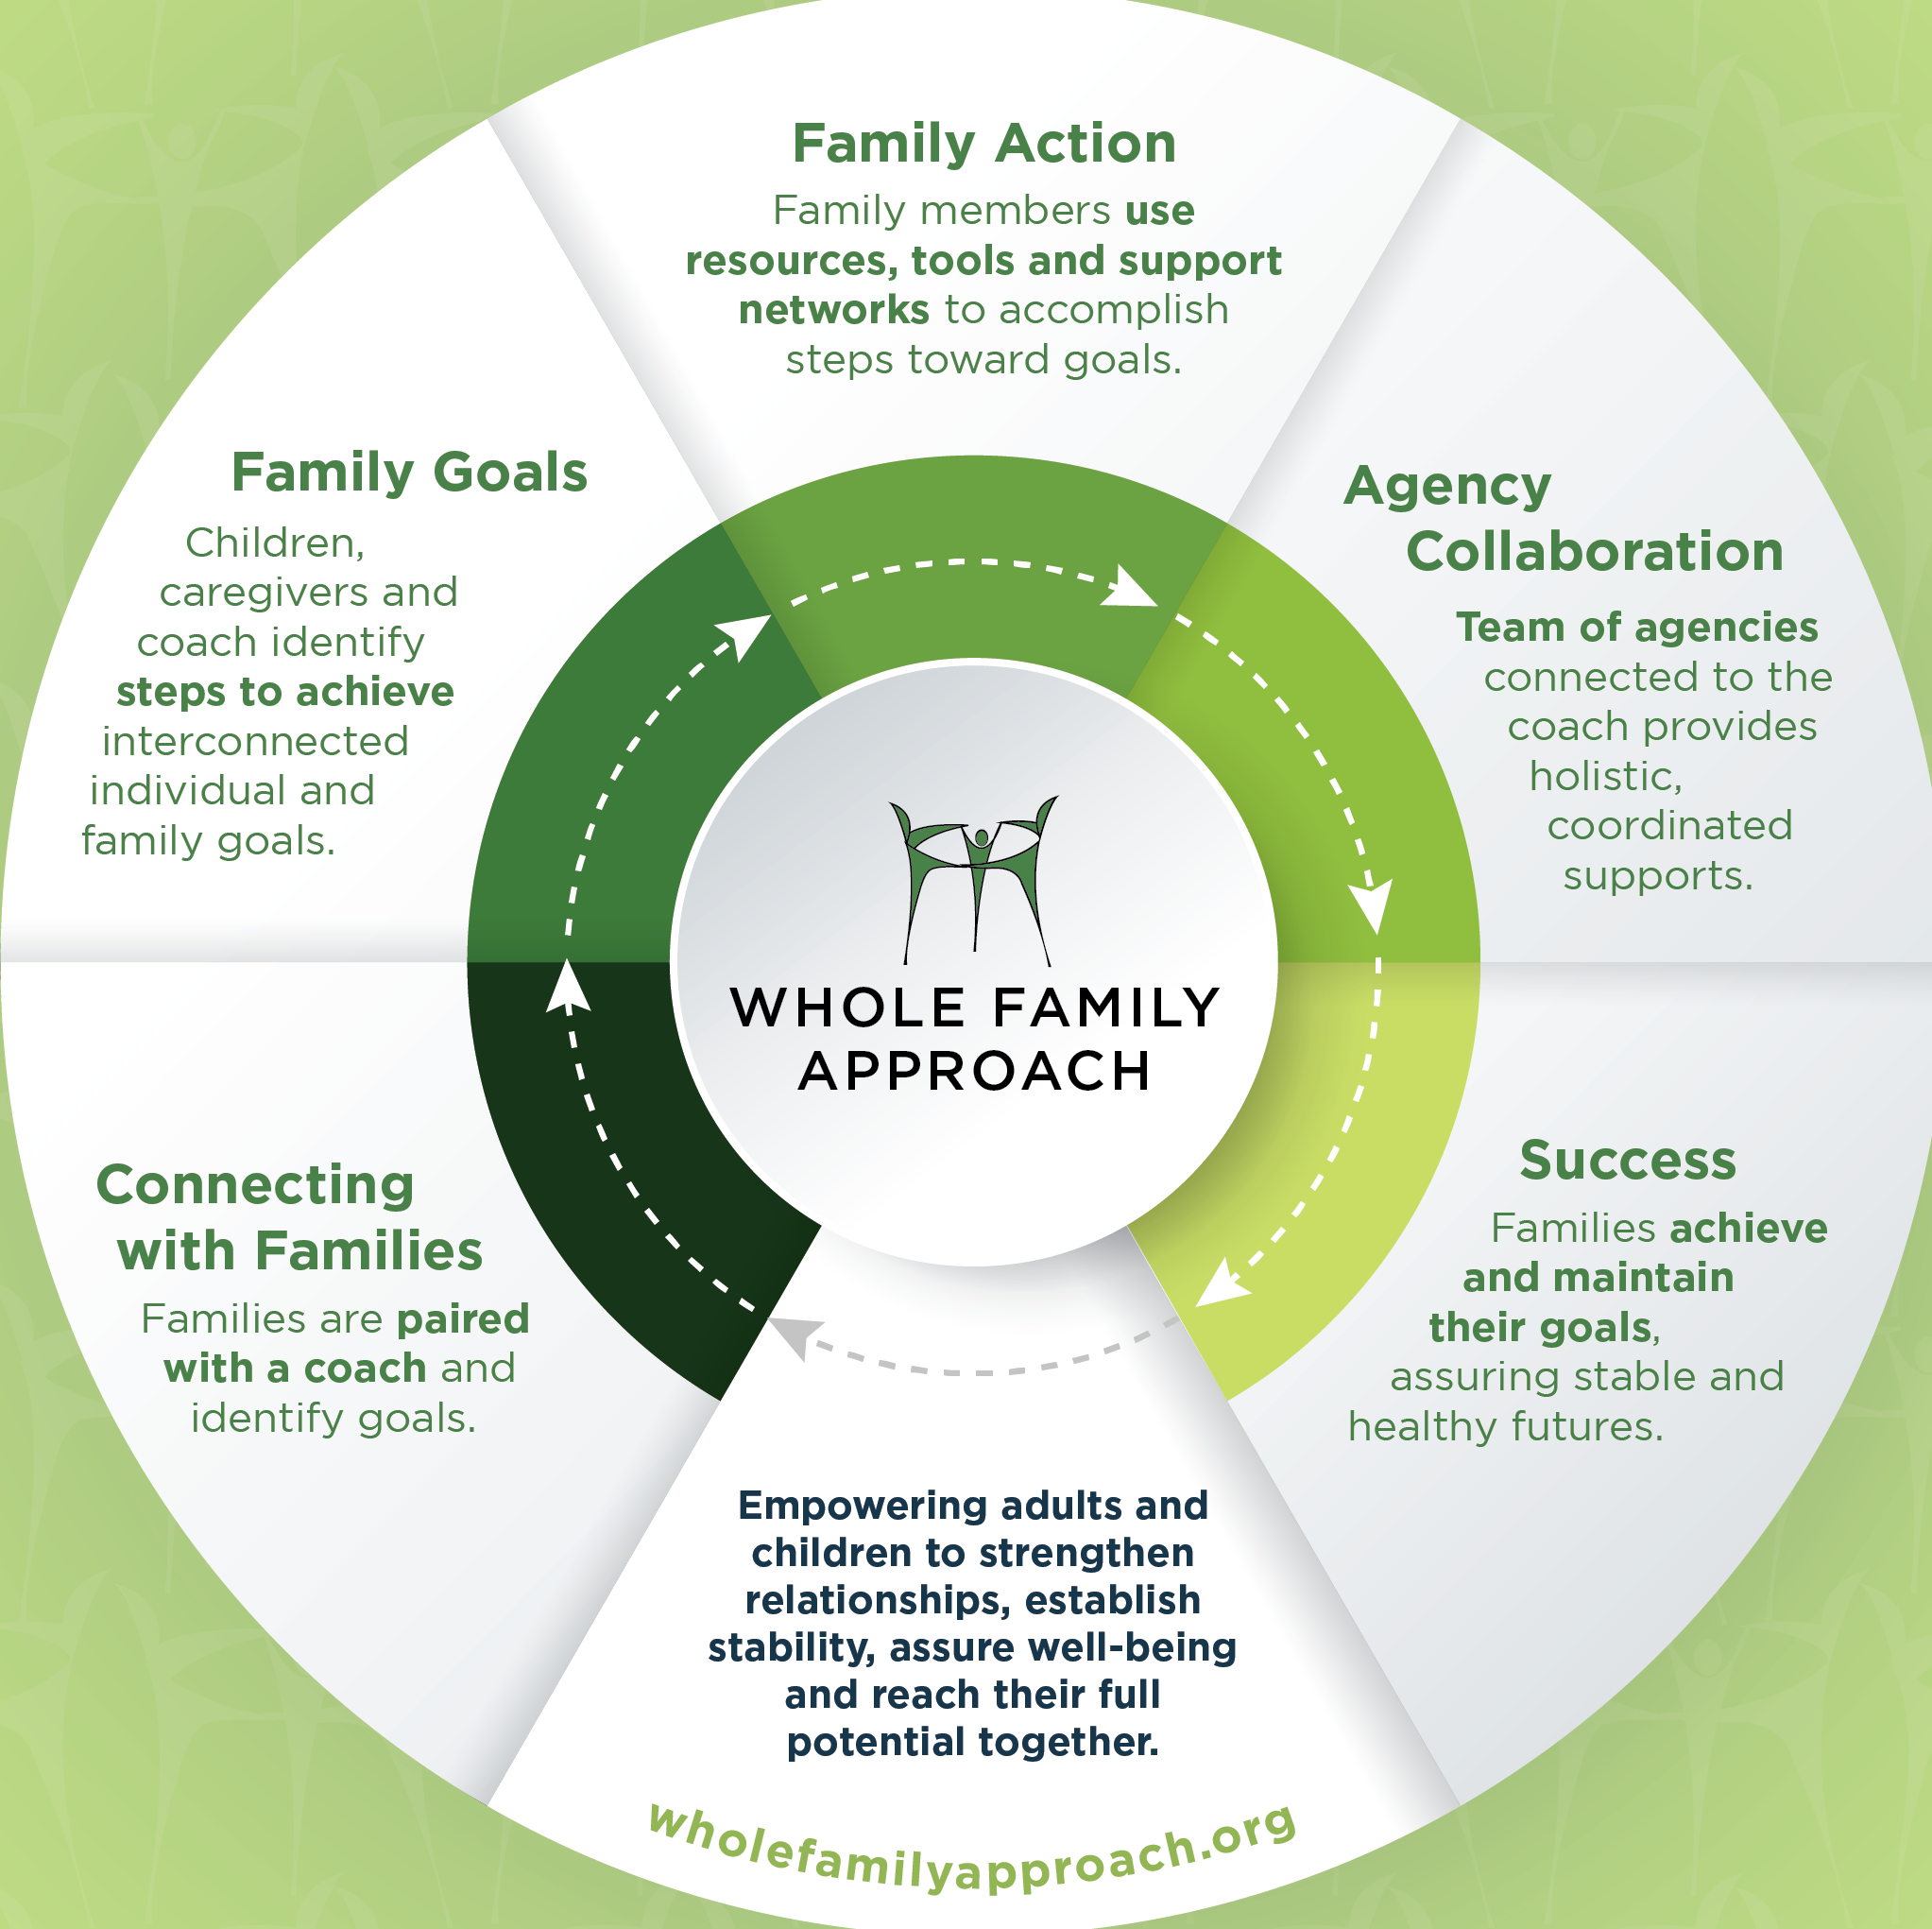

Slide 11
If you don’t have a copy of the Rand and UPenn studies, you can access them through the website below.
http://www.wholefamilyapproach.org/our-impact/

Slide 12

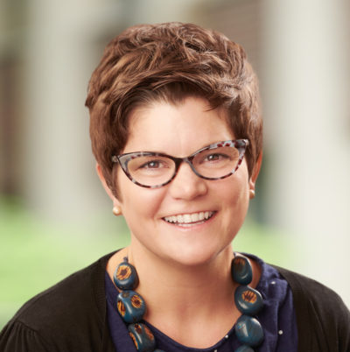


Ross Whiting, Ph.D.
Director of Research and Evaluation, Senator Walter Rand Institute for Public Affairs at Rutgers University-Camden
Amy Castro Baker, Ph.D., MSW
Assistant Professor, University of Pennsylvania School of Social Policy & Practice

Slide 13

The Whole Family Approach: Evaluation Results
OCT
27
Pascale Sykes Foundation’s South Jersey Strengthening Families Initiative
Ross Whiting, Ph.D.
Director of Research and Evaluation
The Senator Walter Rand Institute for Public Affairs
Rutgers University-Camden

Slide 14

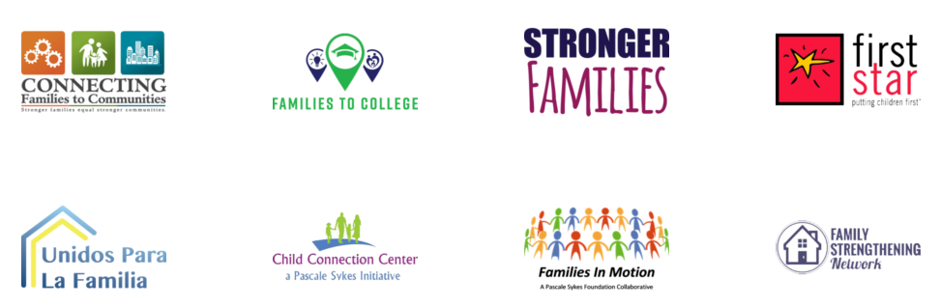
The Whole Family Approach:
South Jersey
Focused on families trying to get ahead: two-caregivers, all family members involved
Goal setting, supports, growth-oriented collaboration

Slide 15
Evaluation Objectives
Determine the impact of the Whole Family Approach on families in Southern New Jersey
Assess changes in service provision and organizational collaboration.

Slide 16
Evaluations
Changes: Surveys in 6-month intervals for 24 months since 2013.
Processes: Observations, focus groups, and document review
Focused Evaluations:
  Child Connection Center: grades, strengths and difficulties, other impacts.
  Family Strengthening Network: holistic impacts on families
  Cultural responsiveness of the Whole Family Approach: impact on Spanish speaking immigrant families
4. COVID-19 Impacts, Supporting Collaboratives
  Qualitative evaluation of collaboratives’ work with the Whole Family
  Approach during the COVID-19 pandemic.

Slide 17
Changes
Two comparison groups:
  Target Families: two-adult households engaged with collaboratives
  Matching Families: two-adult households in similar communities
Characteristics:
477 families; 346 target, 131 matching
Married couples: 50% target, 67% matching
Target families lower income than matching
Adult 1 88% women, 12% men – Adult 2 57% men, 43% women
  Sample: 67% women, 33% men
Analysis for Adult 1/2: baseline difference, change, difference over time.

Slide 18
Approach
Quantitative Results
rand.camden.rutgers.edu

Slide 19
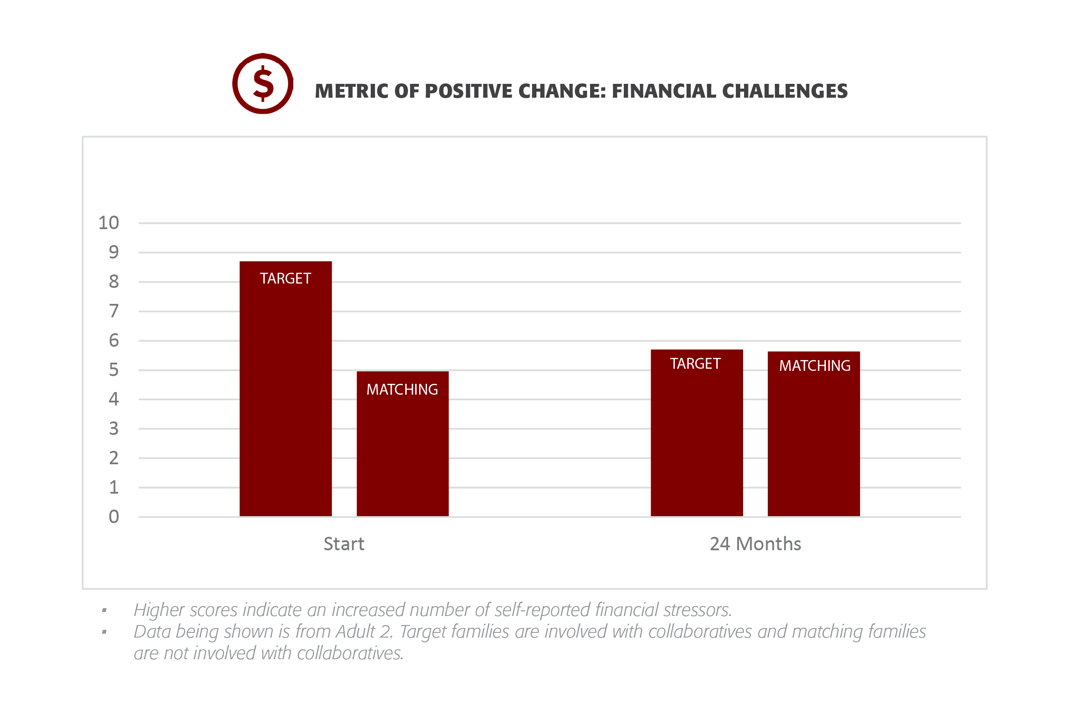

Slide 20
Results:
Financial Challenges
Higher scores indicated an increased number of self-reported financial stressors
A2: Target families had a lower score than matching
A2: Women a lower score than men over time
A2: Higher income had a lower score
A2: Married individuals had a lower score

Slide 21
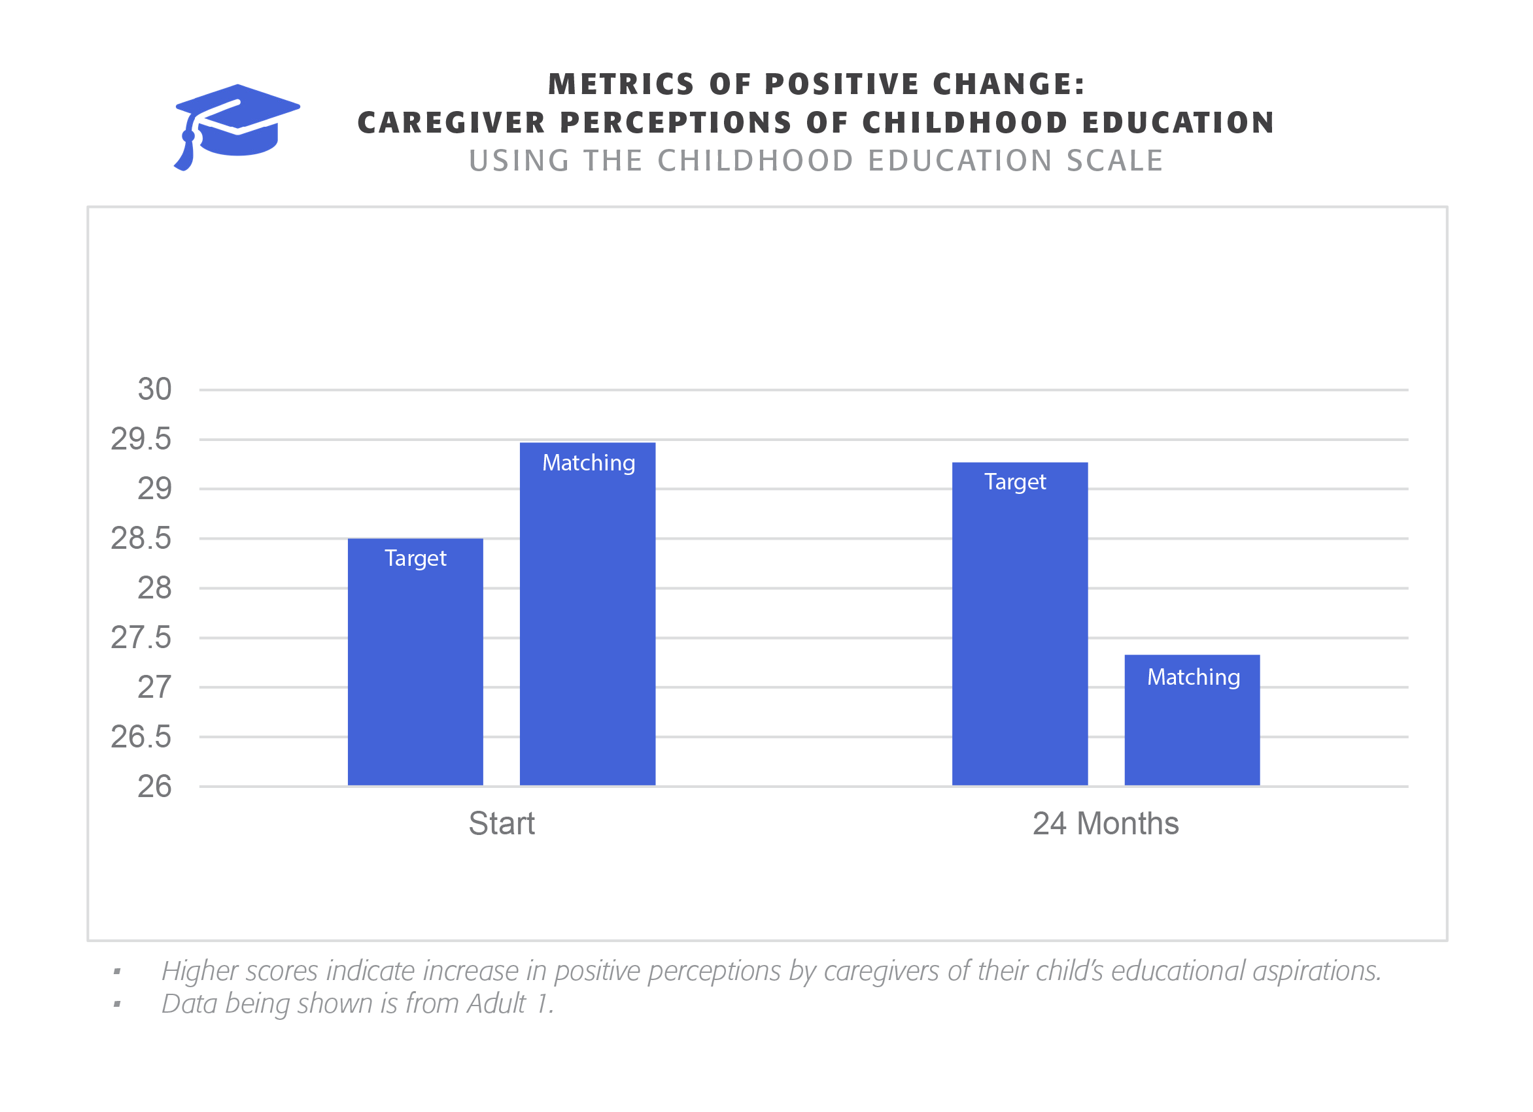

Slide 22
Results:
Child Education
Higher scores indicate an increase in positive perceptions by caregivers of their child’s educational aspirations.
A1: Difference at baseline and growth over time
Affected by education level, education over time, and health
A1: Women higher scores than men, growth for men and women, a significant difference over time for men than women
A1: All income levels grew over time
A1 FSN: All income levels grew over time
A2 FSN: Growth for men and women, and married/unmarried couples

Slide 23
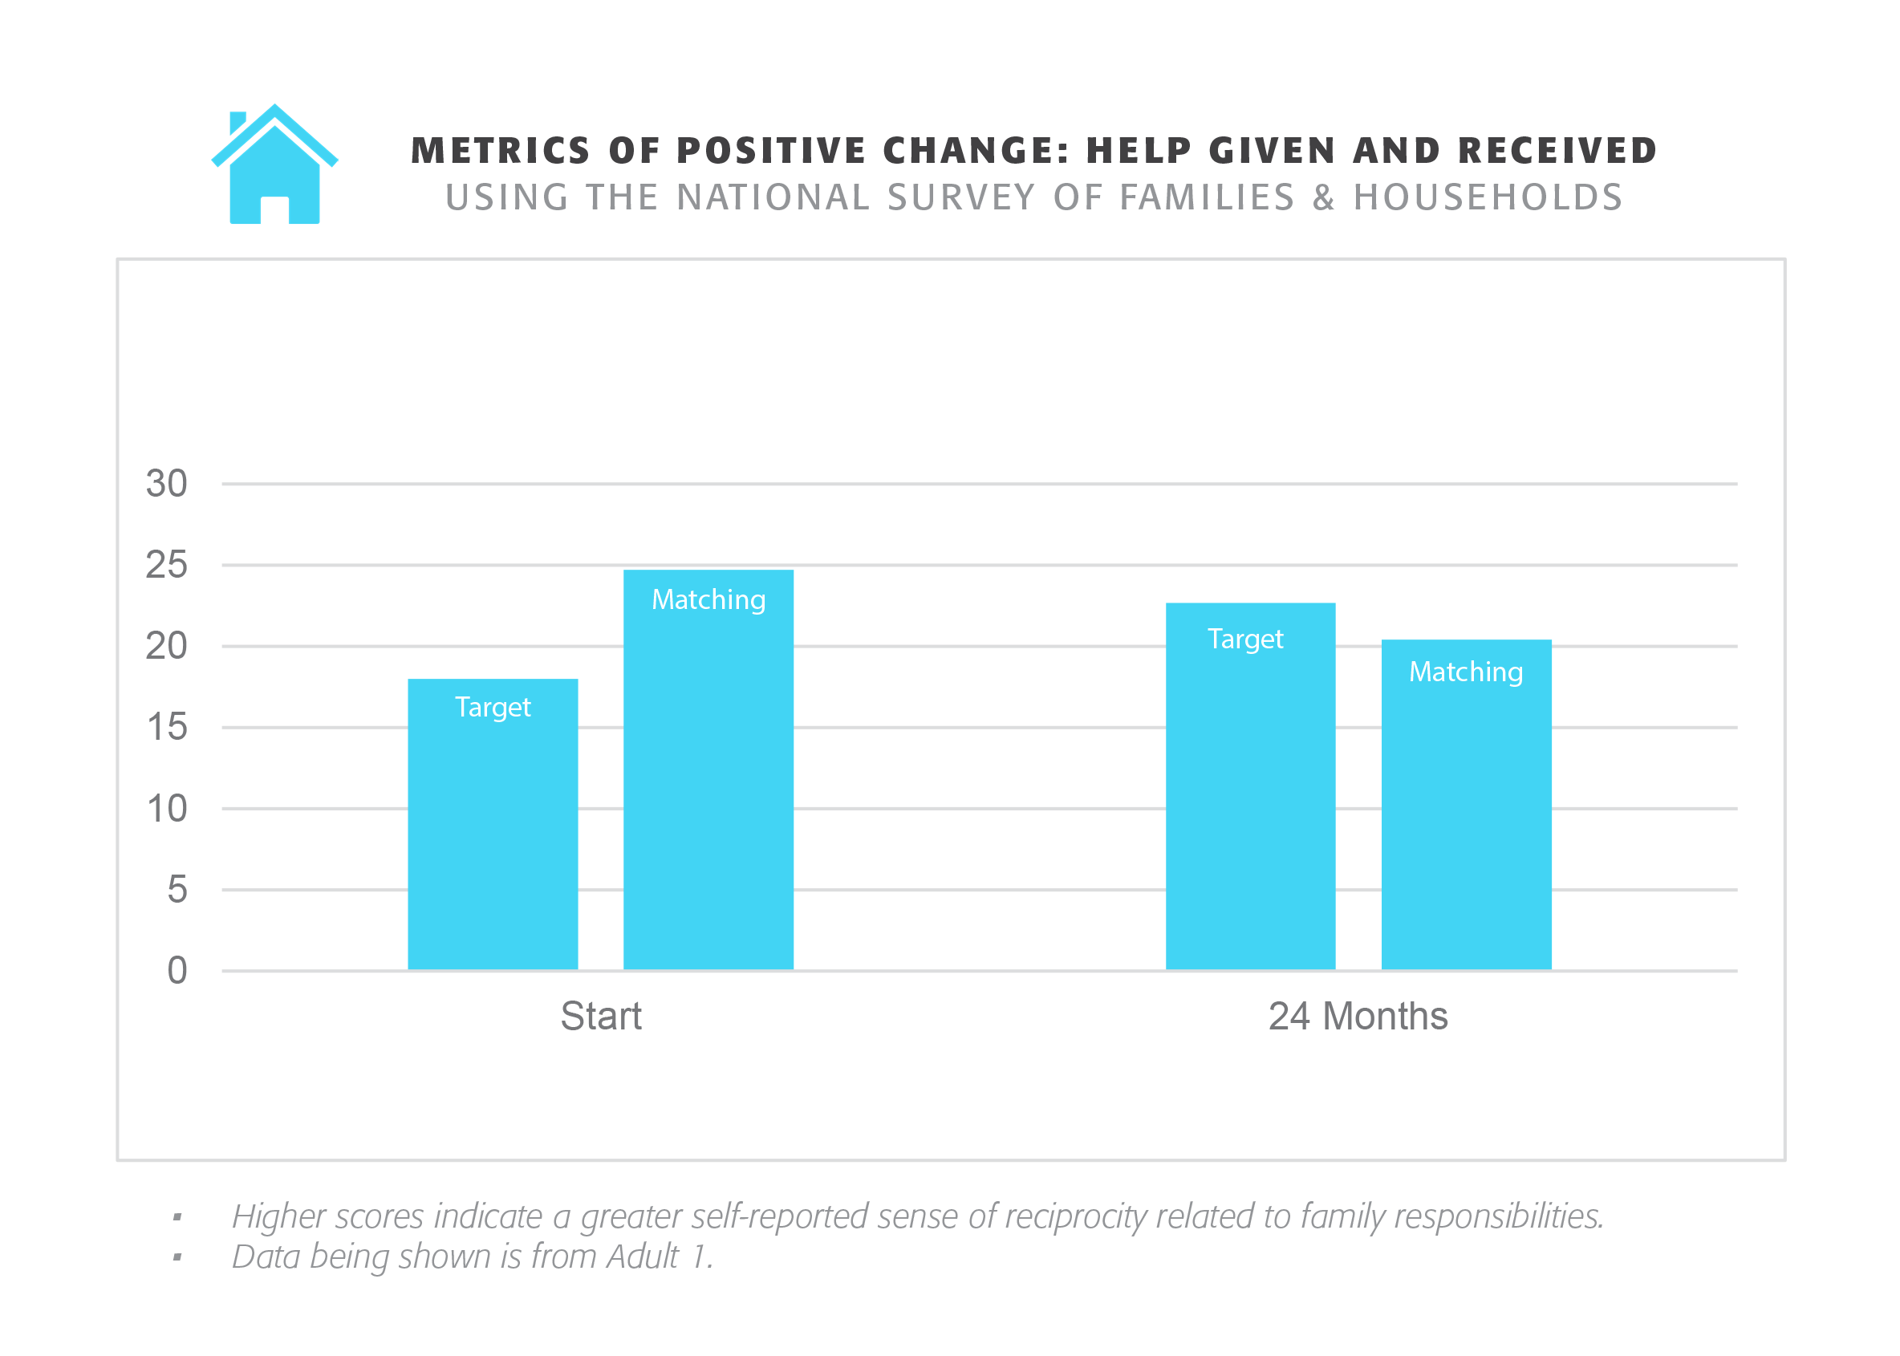

Slide 24
Results:
Help Given and Received
Higher scores indicate a greater self-reported sense of reciprocity related to family responsibilities.
A1: Support at baseline, higher over time for target vs. matching
Affected by income (higher is better), gender (women more than men), and marital status (married better than unmarried)
A1: Significant growth for both men and women
A1: Higher income had more at intercept and growth over time than lower income; all grew over time
Affected by gender (women grew more) and income (higher is better)
A1: Married had more at intercept; all grew over time
Affected by gender (women grew more) and income (higher is better)

Slide 25
Results:
Help Given and Received
A2: Growth over time
Affected by gender (women grew more), and income (higher is better)
A2: Men and women both grew over time
A1 FSN: Growth over time by gender (women grew more) and marital status (married grew more)
A2 FSN: Growth over time by marital status (married grew more)
A1 CF2C: Growth over time based on marital status (married grew more)
A1 CCC: Growth over time based on income (higher is better)

Slide 26
Summary of Quantitative Findings
Help Given and Received
A1/A2 growth, A1 significant difference Target vs Matching
Child Education
A1 growth over time; women higher than men, growth for both, significant difference for men compared to women over time
Financial Challenges
A2 Target has significantly fewer than matching over time
Women had significantly fewer than men

Slide 27
Approach
Process Evaluation
rand.camden.rutgers.edu

Slide 28
Process Methods
Notes from Collaborative meetings and focus groups
Open coded to identify new themes

Slide 29
Process Findings: Collaboratives
Flexibility
Collaboratives serve:
Families who need support to help their children thrive
Immigrant families
Foster youth and their families
Families living in poverty
Families with unrelated caregivers who are committed to improving children’s lives
Focus on education, community development, youth development, organizational collaboration, family, recruitment, and ESL.

Slide 30
Approach
Focused Studies
Implemented: Child Connection Center
Planned: Family Strengthening Network
Planned: Cultural Responsiveness of the Whole Family Approach
rand.camden.rutgers.edu

Slide 31
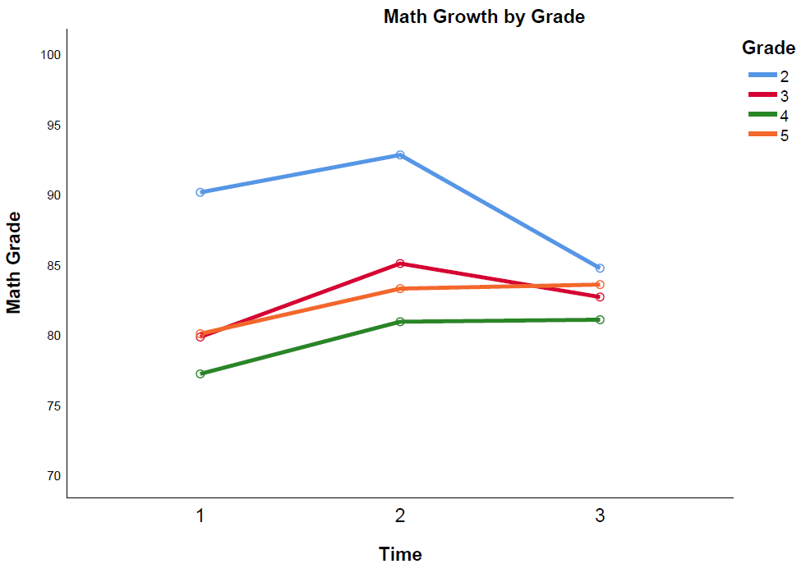
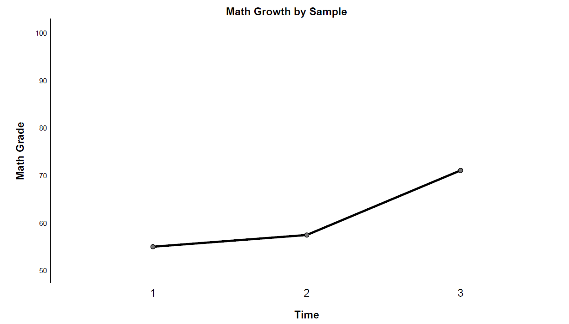
Child Connection Center:
Math Grades

Slide 32
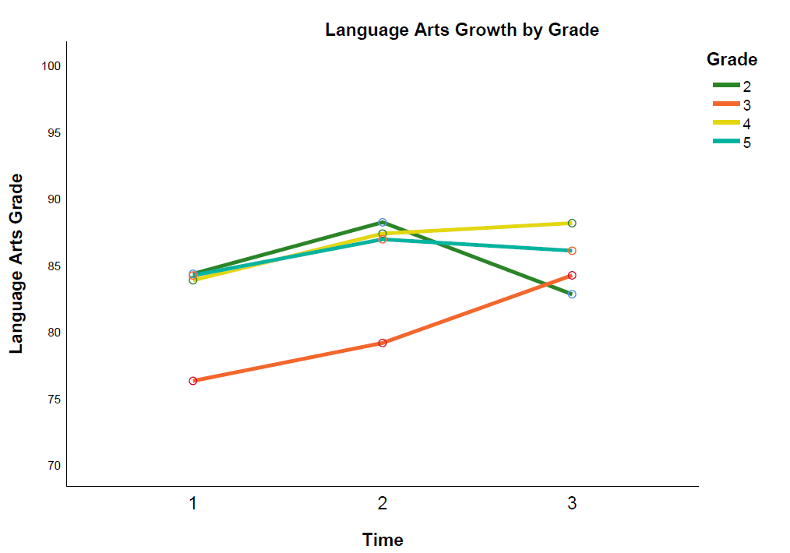
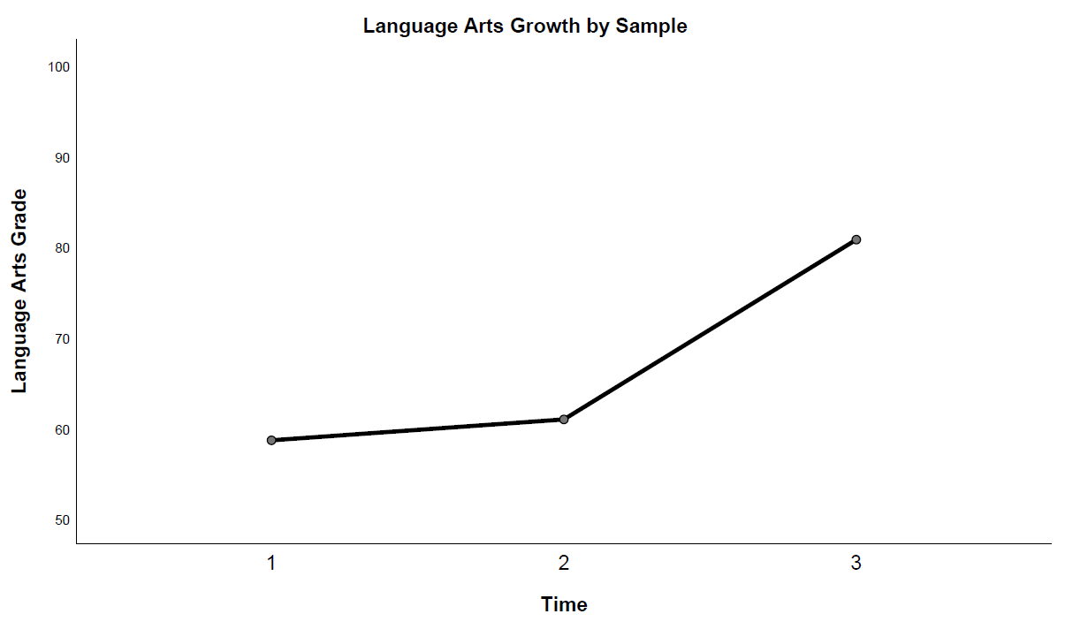
Child Connection Center:
Language Arts Grades

Slide 33
Child Connection Center:
SDQ
Parents and teachers: rate students’ social, emotional, and behavioral changes over three months of involvement with CCC
25 question Strengths and Difficulties Questionnaire
Emotional symptoms,
Behavior problems
Hyperactivity and in attentiveness
Peer relationship problem
Prosocial behavior
Overall change
Impact on the child’s life

Slide 34
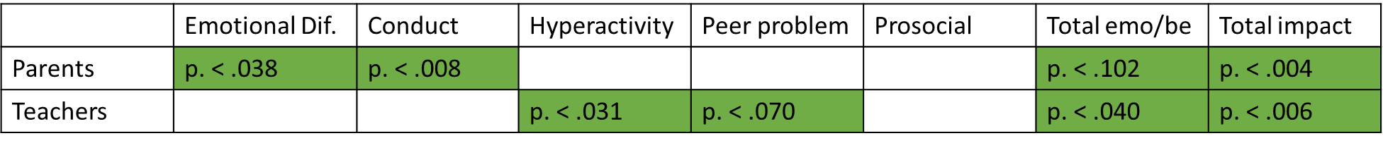
Child Connection Center:
SDQ Results
Environment Matters!
Parents: reduction in emotional difficulties, improvement in conduct
Teachers: reduction in hyperactivity and peer-problems
Both: Total emotional/behavioral difficulty reduced, impact on kids

Slide 35
Approach
COVID Impacts
Supporting Collaboratives
A qualitative evaluation of collaboratives’ work with the Whole Family Approach during the COVID-19 pandemic
rand.camden.rutgers.edu

Slide 36
Methods
Goal: examine the range of responses collaboratives have implemented during COVID-19.
May 6 – June 10, 2020
Interviews with staff:
  Changes implemented
  Support: mental health/wellness, communication, culture
  Pressing issues/key needs for families
  New resources, challenges, and barriers
  Protective factors of the Whole Family Approach
27 staff from eight collaboratives

Slide 37
Organizational Changes
Uses of Technology: Worked to reach more families digitally and modify/extend in-person formats. Collaboratives worked to meet family needs. Experiences varied:
- Respite communicating with people outside of their homes;
- Classes or meetings could be overwhelming or a burden;
- Basic lack of technology at home.
Staff Members’ Changing Roles: Sharing online resources, creating home activities for kids, resource hotlines for families, wellness check-ins. Remotely supporting families with health, financial, and academic needs.

Slide 38
Family Changes
‘School being at home’: Support with online resources, support and advocacy for students with disabilities, virtual services sometimes more accessible and wide-reaching.
Self-Isolation: Increased anxiety, uncertainty, concerns about keeping children safe once parents return to work.
Family Resilience: Increased anxiety, stress, fear, new mental health concerns.
Safety Issues: Accurate COVID-19 info important; food security, transportation, housing, employment safety, and domestic violence.
Navigating Formal Institutions: Collaboratives supported whenever possible; larger systems inadequately addressed needs or did not mitigate negative impacts.

Slide 39
“The most effective piece of the Whole Family Approach with our families is having them know there’s a support system for them…Knowing there are individuals that they can reach out to has been instrumental.”
– Staff member interview, May 14, 2020

Slide 40
Whole Family Approach
Families were better positioned to handle the crisis: strong familial ties, support from collaboratives, and an opportunity to focus on the entire family.
Informal Networks: More information sharing between staff, collaboratives, and families; marked increase in resource and information sharing. Greater institutional effort to match family needs to resources.
Collaborative Response: Alter service delivery to meet needs; connected to PSF and other resources to ensure material needs were met, including technology, bills, and food.
Rapport and Relationships: Trust between families and community leaders at collaboratives crucial; meeting family needs.

Slide 41
THANK YOU
Approach
Ross Whiting, Ph.D.
Director of Research and Evaluation
Senator Walter Rand Institute for Public Affairs
Rutgers University-Camden
ross.whiting@rutgers.edu
rand.camden.rutgers.edu

Slide 42


Slide 43

Urban Family
Resilience
Amy Castro Baker, PhD, MSW
University of Pennsylvania School of Social Policy & Practice
Collaboratives: Familia Adelante & Families for Literacy

Slide 44
Agenda
Whole Family Approach: Urban Context
Collaborative Structure: Urban Context
Pre-COVID
  Family Trends
  Collaborative Trends
COVID
  Model Adaptability
Policy Implications

Slide 45
Urban Context
Bronx & Jersey city
Key Questions!
  How does the Whole Family Approach and Collaborative Structure function in an urban environment?
  What are the unique barriers and opportunities for families in this context?
  How does the structure adapt based on these variations?
  What are the drivers for economic instability and how can the model adapt?

Slide 46
Pre-covid : Methodology
Mixed-Methods Approach: QUANT + QUAL
Quasi-experimental design/Clinical Data-Mining/Semi-structured interviews
Outcomes across four domains: (Child Well-Being; Adult Well-Being; Healthy Relationships; Financial Stability & Mobility)
Long-form survey every 6 months. (English; Arabic; Spanish; Adult Caregivers; Youth ages 10-18.
Scales: PANAS; PHQ-9; Protective Factors; Phinney Multi-Group Ethnic Identity; Duke Spirituality & Religiosity; ACOPE; Hope; Mattering; Future Events; FEQA; ACES; ESI; FCAB; FSS

Slide 47
Pre-Covid : youth
Child Well-Being: Goals, Perceptions, Affect, & Relationships
Affect & Goals Significantly increased from wave 1 to wave 5
Greatest changes in:
  Visualization of Pathways Towards Goals
  Feeling positively seen and heard by their parents
Seasonal Variation

Slide 48
Pre-Covid : Adult S
Employment rates steadily increased
Financial Capability increased across all waves
Well-Being fluctuates seasonally
One exception! Reliance & Social Supports!
Whole Family Implementation Take-Away: Imperative that agencies take work-life & housing costs/type into account.

Slide 49
Clinical Data-Mining : Disrupting Status quo & siloed service delivery
Hallmarks of the Whole Family Collaborative Approach:
  Integrated Data-System
  Common Collaborative Funding Stream
  Decrease in Inefficiency= Increase in Family Contact Hours
  Adaptable Model fits fluctuating urban context
  Logic Model creates an adaptive mechanism capable of responding quickly to COVID-19 and other unexpected stressors or shocks outside of client’s control.

Slide 50
Covid-19 Impact
Both collaboratives were at the center of earliest and most severe pandemic impact
Collaborative Whole Family Approach Structure facilitated a nimble ”rapid-response” in the following areas:
    Maintaining Social Supports
    Technology Assistance
    Food & Financial Aid
    Family Adaptation under extreme duress

Slide 51
Policy implications
Risk
Adaptability of the Model
Integrated Data Systems & An Increase in Efficiency
Structural “wrap-around” response that mirrors the family goals
Collaborative Structure Worked in tandem with public health guidelines– KEY– since most participants were either essential workers OR gig/shift workers who immediately lost work without warning.

Slide 52


Slide 53
Thank you
PascaleSykesFoundation.com
WholeFamilyApproach.org

