Slide 1
Evaluation: Results and Future Directions
Pascale Sykes Foundation’s South Jersey Strengthening Families Initiative
Ross Whiting, Ph.D.
Director of Research and Evaluation
The Senator Walter Rand Institute for Public Affairs
Rutgers University-Camden
February 13, 2020

Slide 2
The Whole Family Approach: South Jersey
Focused on families trying to get ahead: two-caregivers, all family members involved
Goal setting, supports, growth-oriented collaboration

Slide 3
Evaluation Objectives
Determine the impact of the Whole Family Approach on families in Southern New Jersey.
Assess changes in service provision and organizational collaboration.

Slide 4
Evaluations
Changes: Surveys in 6-month intervals for 24 months since 2013
Processes: Observations, focus groups, and document review
Focused Evaluations:
Child Connection Center: grades, strengths and difficulties, other impacts.
Family Strengthening Network: holistic impacts on families
Cultural responsiveness of the Whole Family Approach: impact on Spanish speaking immigrant families

Slide 5
Changes
Two comparison groups:
Target Families: two-adult households engaged with collaboratives
Matching Families: two-adult households in similar communities
Characteristics:
477 families; 346 target, 131 matching
Married couples: 50% target, 67% matching
Target families lower income than matching
Adult 1 88% women, 12% men – Adult 2 57% men, 43% women
Sample: 67% women, 33% men
Analysis for Adult 1/2: baseline difference, change, difference over time.

Slide 6
Quantitative Results

Slide 7
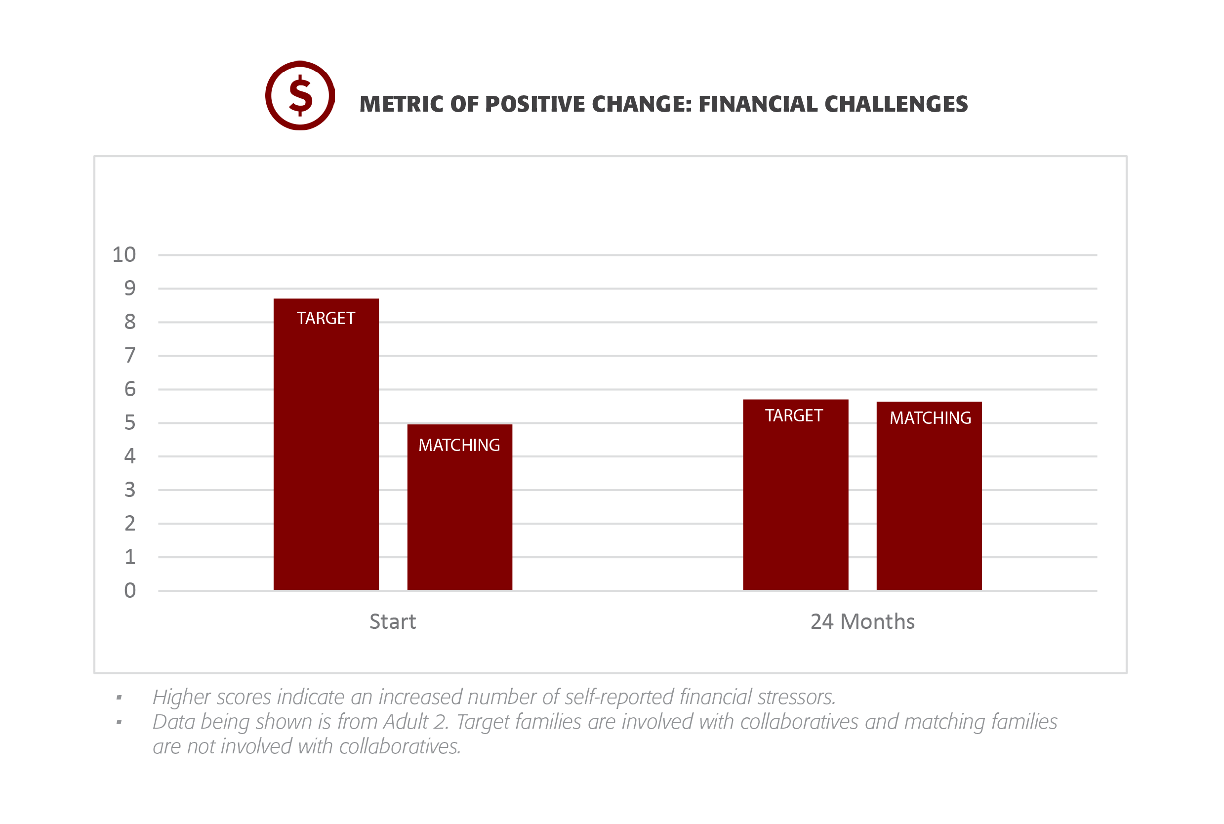

Slide 8
Results: Financial Challenges
Higher scores indicated an increased number of self-reported financial stressors
A2: Target families had a lower score than matching
A2: Women a lower score than men over time
A2: Higher income had a lower score
A2: Married individuals had a lower score

Slide 9
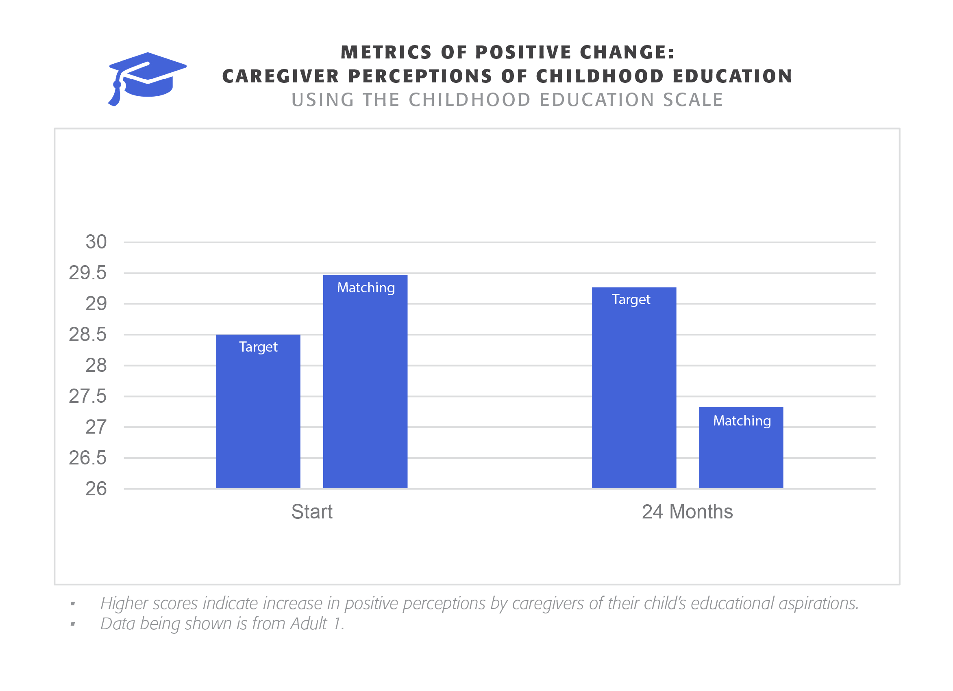

Slide 10
Results: Child Education
Higher scores indicate an increase in positive perceptions by caregivers of their child’s educational aspirations.
A1: Difference at baseline and growth over time
Affected by education level, education over time, and health
A1: Women higher scores than men, growth for men and women, a significant difference over time for men than women
A1: All income levels grew over time
A1 FSN: All income levels grew over time
A2 FSN: Growth for men and women, and married/unmarried couples

Slide 11
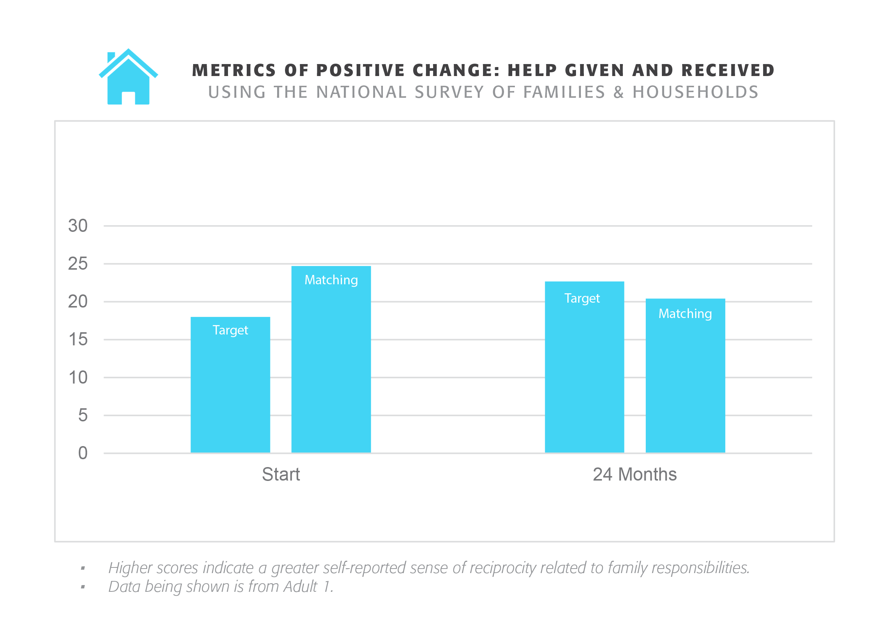

Slide 12
Results: Help Given and Received, Adult 1
Higher scores indicate a greater self-reported sense of reciprocity related to family responsibilities.
A1: Support at baseline, higher over time for target vs. matching
Affected by income (higher is better), gender (women more than men), and marital status (married better than unmarried)
A1: Significant growth for both men and women
A1: Higher income had more at intercept and growth over time than lower income; all grew over time
Affected by gender (women grew more) and income (higher is better)
A1: Married had more at intercept; all grew over time
Affected by gender (women grew more) and income (higher is better)

Slide 13
Results: Help Given and Received, cont.
A2: Growth over time
Affected by gender (women grew more), and income (higher is better)
A2: Men and women both grew over time
A1 FSN: Growth over time by gender (women grew more) and marital status (married grew more)
A2 FSN: Growth over time by marital status (married grew more)
A1 CF2C: Growth over time based on marital status (married grew more)
A1 CCC: Growth over time based on income (higher is better)

Slide 14
Summary of Quantitative Findings
Help Given and Received
A1/A2 growth, A1 significant difference Target vs Matching
Child Education
A1 growth over time; women higher than men, growth for both, significant difference for men compared to women over time
Financial Challenges
A2 Target has significantly fewer than matching over time
Women had significantly fewer than men

Slide 15
Process Evaluation

Slide 16
Process Methods
Notes from Collaborative meetings and focus groups
Open coded to identify new themes

Slide 17
Process Findings: Collaboratives
Flexibility
Collaboratives serve:
Families who need support to help their children thrive
Immigrant families
Foster youth and their families
Families living in poverty
Families with unrelated caregivers who are committed to improving children’s lives
Focus on education, community development, youth development, organizational collaboration, family, recruitment, and ESL.

Slide 18
Focused Studies
Implemented: Child Connection Center
Planned: Family Strengthening Network
Planned: Cultural Responsiveness of the Whole Family Approach

Slide 19
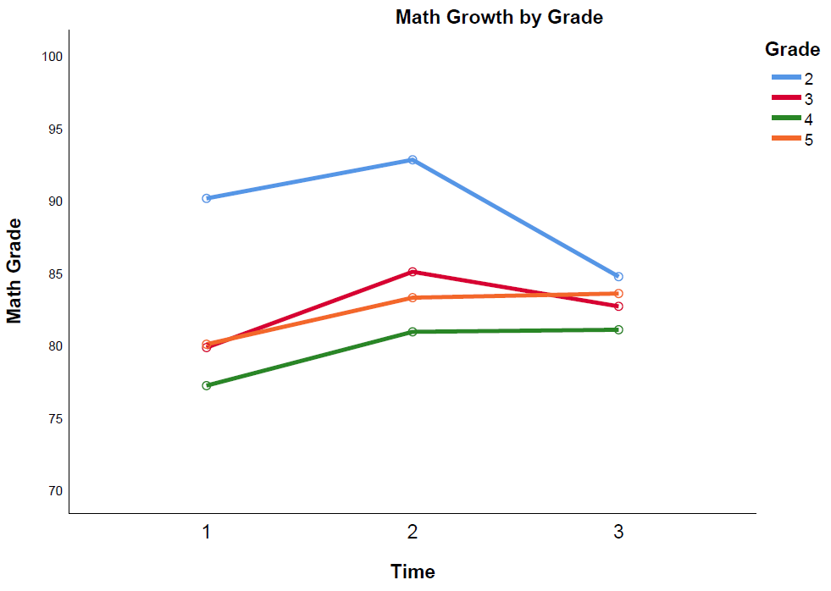
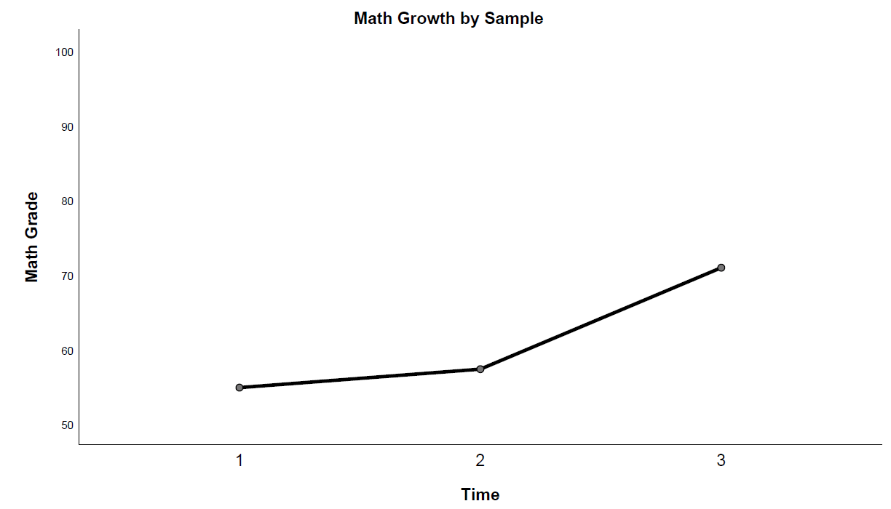
Child Connection Center: Math Grades
Positive change overall; positive change for 3rd, 4th, and 5th grade

Slide 20
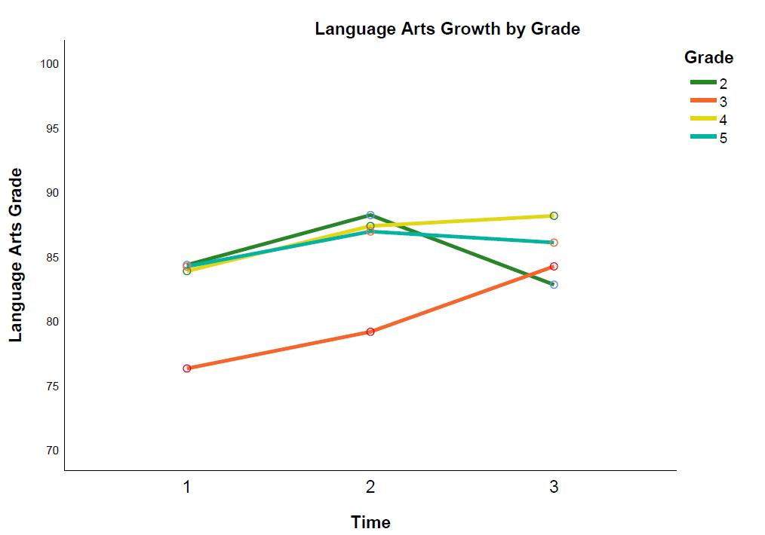
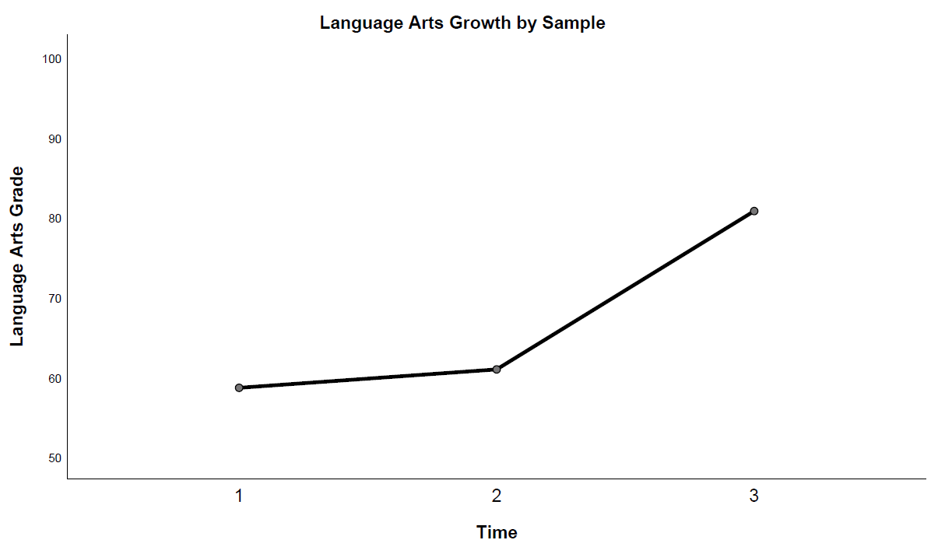
Child Connection Center: Language Arts Grades
Positive change overall; positive change for 3rd, 4th, and 5th grade

Slide 21
Child Connection Center: SDQ
Parents and teachers: rate students’ social, emotional, and behavioral changes over three months of involvement with CCC
25 question Strengths and Difficulties Questionnaire
Emotional symptoms,
Behavior problems
Hyperactivity and in attentiveness
Peer relationship problem
Prosocial behavior
Overall change
Impact on the child’s life

Slide 22
Child Connection Center; SDQ Results
Environment matters!
Parents: reduction in emotional difficulties, improvement in conduct
Teachers: reduction in hyperactivity and peer-problems
Both: Total emotional/behavioral difficulty reduced, impact on kids
Wave II: Sept 2019-June 2020
Additional impact: schools?

Slide 23
Whole Family Approach Evaluation: Summary
Strengthens Families
Flexible
Positively Impacts Kids

Slide 24
Thank you!
Contact Information:
Ross Whiting, Ph.D.
Director of Research and Evaluation
Senator Walter Rand Institute for Public Affairs
Rutgers University-Camden
e-mail: ross.whiting@rutgers.edu
p. 856-225-6846

