Slide 1
Working Together for Working Families Pascale Sykes Foundation
Marjorie Sims, Managing Director, Ascend at the Aspen Institute

Slide 2
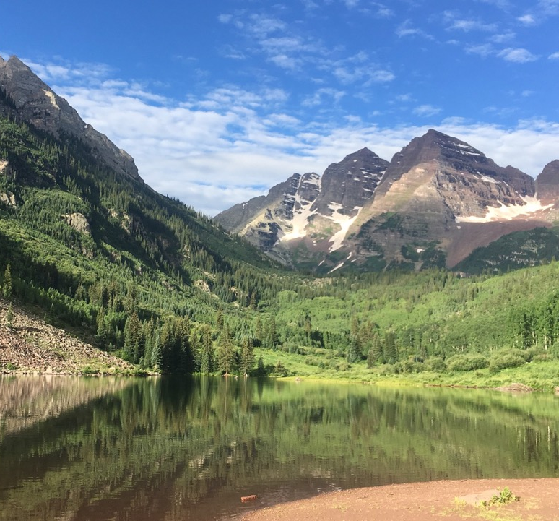
The Aspen Institute: Principles that Endure and Inspire
The Aspen Institute is an educational and policy studies organization with the mission of fostering values-based leadership and providing a nonpartisan venue for dialogue around critical issues.
The timeless values that inspired the creation of the Institute after World War II continue to guide us today.

Slide 3
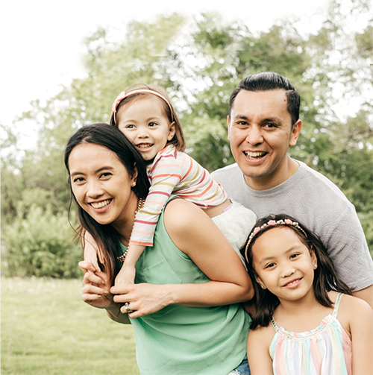
Ascend at the Aspen Institute: A New Way Forward for Children and Families
Ascend at the Aspen Institute is the national hub for breakthrough ideas and collaborations that move children and the adults in their lives toward educational success, economic security, and health and well-being.
We embrace a two-generation approach and a commitment to racial equity and a gender lens. How we work:
Convene and communicate
Build leadership and a national network
Advance practice and policy solutions

Slide 4
Our Vision

Slide 5
The Two-Generation (2Gen) Approach
Two-generation (2Gen) approaches build family well-being by intentionally and simultaneously working with children and the adults in their lives together.

Slide 6
Why a 2Gen Approach?
Research shows that supporting children and their caregivers together has an outsize impact for generations.
A college degree doubles a parent’s income.
A $3,000 increase during early childhood yields a 17% increase in adult earnings.
The brains of new parents undergo major changes.
Research demonstrates a 13% ROI in high quality early childhood education.
Parents with health insurance are more likely to seek care for their children.

Slide 7
Many Names. One Approach.
“Multi-Gen”
“Next Gen”
“Whole Family”
“Intergenerational”
“’Ohana Nui”
“Multi-generational”
“Two-Generation”
“Family Economic Mobility”
“2Gen”

Slide 8
Principles to Put Children and Families at the Center
Measure and account for outcomes for both children and their parents
Engage and amplify the voices of families
Ensure equity
Foster innovation and evidence together
Align and link systems and funding streams

Slide 9
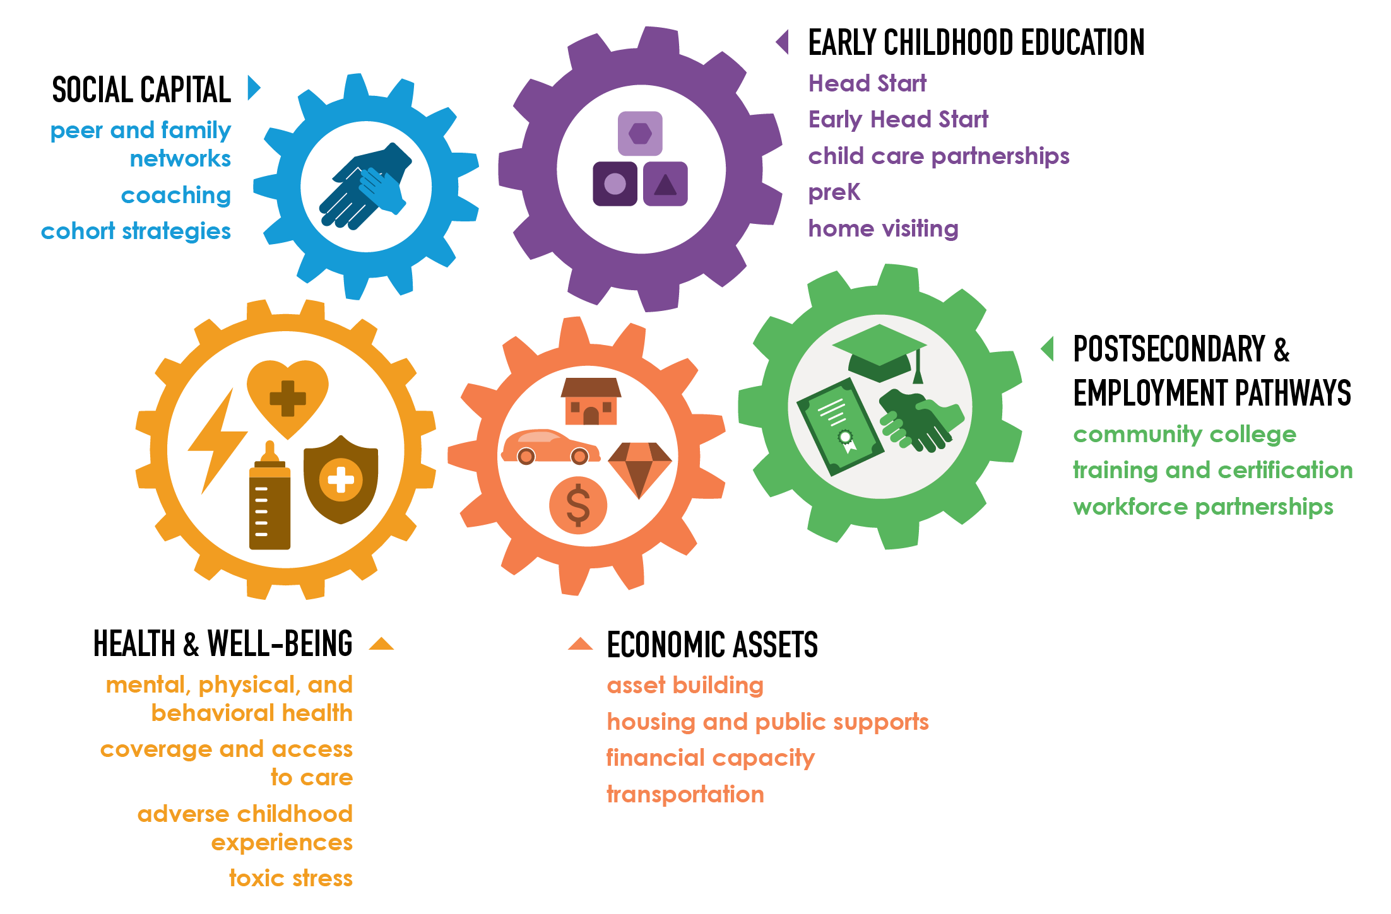
2Gen Core Components

Slide 10
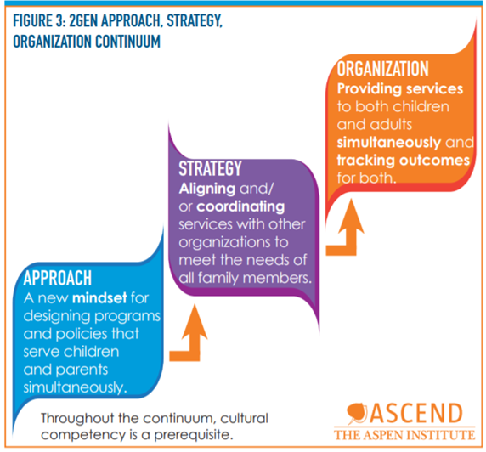
Reimagining organizations to serve whole families
Whole Family Approach, Strategy, Organization Continuum

Slide 11
2Gen Community Continuum: Stages of 2Gen Implementation
2Gen Unaware: Fragmented programs and systems due to limited understanding of the 2Gen framework.
2Gen Awareness Raising: Stakeholders beginning to learn about 2Gen and engaging others to learn more.
2Gen Approach: Stakeholders aware of and support existing 2Gen organizations, and move on to “development” if there are any gaps.
2Gen Strategy: Cross-sector stakeholders working collaboratively to align and/or coordinate programs, policies, organizations and systems to reflect the 2Gen framework and ingrain it in their mission.
2Gen Pilot or Initiative: Cross-sector stakeholders working collaboratively to provide services to both children and adults simultaneously.
2Gen Integration: Both children and adults are being simultaneously served in multiple programs across multiple sectors.
2Gen Accountability: Sustained programs, policies and practices.

Slide 12
Key Challenges and Barriers to 2Gen Implementation
Lack of clear collaboration partners and/or terms of agreement
Staff buy-in and capacity
Parent recruitment and retention
Knowledge of and access to blended funding streams
Policy barriers: lack of aligned resources and policies

Slide 13
2Gen Momentum: By the Numbers
388 Ascend Network Partners active in 49 states and the District of Columbia, serving more than 3 million people
80 Ascend National and Colorado Fellows in 28 states
12 states and 5 cities/counties implementing leading 2Gen policies
7 states with “2Gen Coordinator” managing efforts at the state/systems level
AK
AK
HI
Notes:
In 2017, when I presented at the previous convening, Ascend had 171 Network Partners in 36 states and the District of Columbia

Slide 14
2Gen Momentum: Confluence of Strategies and Investments
Key
Ascend Network
W.K. Kellogg Foundation STEPS grantees
Annie E. Casey Foundation 2Gen sites
Educare Learning Network 2Gen Acceleration grantees
State human service depts. with 2Gen strategies
AK
HI
NGA 2Gen State Policy Network
Innovate+Educate and NAWB 2Gen winners
Notes:
----- Meeting Notes (10/24/16 12:40) -----

Slide 15
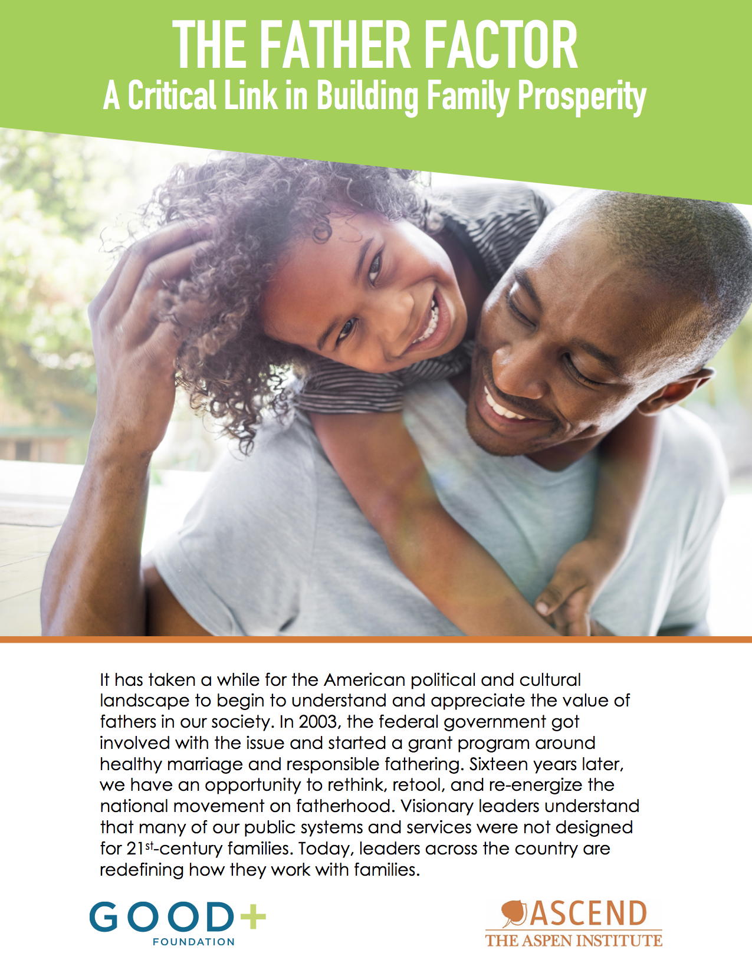
Tools and Publications

Slide 16
Outcomes Bank
outcomes.ascend.aspeninstitute.org

Slide 17
Stay Connected!
ascend.aspeninstitute.org
@AspenAscend
Marjorie.sims@aspeninstitute.org

