Slide 1
Forming and Sustaining a Successful Collaboration
Working Together For Working Families
Whole Family Approach
February 13, 2020

Slide 2
Table of Contents
Introductions (5 mins)
Effective & Ineffective Collaborations (10 mins)
Collaboration & The Whole Family Approach (25 mins)
Familia Adelante/Family Forward
Pureland East-West Community Shuttle
Lessons Learned & Best Practices (10 mins)
Questions & Comments (10 mins)

Slide 3
Paula Sarro, Associate Executive Director Mercy Center
Who is Mercy Center?
30-year-old community center located in the South Bronx, NY
Provides a supportive community and services for over 2,700 low-income, mostly immigrant women, men, and children each year; participants come from over 50 countries
Provides high-quality, holistic educational and social services that help participants to reach their full potential through education, skills acquisition, family strengthening, immigration assistance, and personal development

Slide 4
Michael Gower, Executive Director United Way of Gloucester County
Who is the United Way of Gloucester County?
Mission Statement - The mission of the United Way of Gloucester County is to be the leader in building community capacity to foster individual well being. Through collaboration with the United Way, consumers and providers of health and human services in Gloucester County will be more self-sufficient.
Goals - Be the recognized leader in identifying and addressing critical community needs; Stimulate community involvement; Develop resources sufficient to meet community needs; Affect sustainable solutions; and Enable self-sufficiency.

Slide 5
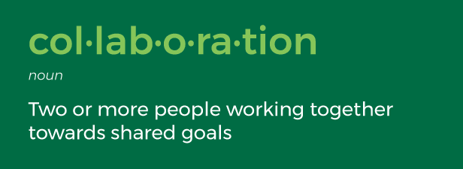
What is a collaboration, why is it important?
Great things in business are never done by one person. They’re done by a team of people. – Steve Jobs
Coming together is a beginning; keeping together is a progress; working together is success. – Henry Ford
Never doubt that a small group of thoughtful, committed citizen can change the world; indeed, it’s the only thing that ever has. - Margaret Mead

Slide 6
Effective & Ineffective Traits
Trust
Respect
Willingness / Cooperation
Empowerment
Effective Communication
Open-mindedness
Organization & Buy-In
Strategy: Long-term thinking (Time)
Adaptability: willingness to change & compromise
Debate
Shared goals and objectives
Clearly defined roles
No processes for gaining consensus or resolving conflicts
Team members who lack a commitment to the goal
Lack of camaraderie
Lack of openness and trust
Vague role definitions
No commonality or cohesiveness
Conformity and mind protection
Low tolerance for diversity
Insufficient resources
Lack of management support
Listless team members
A discontinuity between individual expectations and group expectations

Slide 7
Whole Family Approach
Several factors make the Whole Family Approach unique and effective:
Families include two adult caregivers, one working or able to work, committed to the long-term well-being of the entire family.
Families self-identify goals and work together to accomplish individual and family-wide goals.
Families create and implement plans with behavioral objectives, enabling them to reach their goals together.
Families have access to a range of organizations offering the tools to act on their plans.
Collaborations of agencies support families in achieving goals by coordinating offerings, activities and supports.

Slide 8
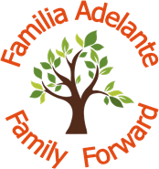
Familia Adelante/Family Forward Collaboration
A collaborative initiative that strengthens immigrant families by helping them establish and achieve family-driven goals in the areas of economic stability, educational opportunities, family functioning, and adult and child well-being
Pascale Sykes Foundation – community change agent, collaboration funder
Mercy Center – serves as lead agency and manages collaboration; provides family workers who support families in achieving goals and accessing resources; promotes family participation in community-building activities
Fiver Children’s Foundation – addresses family members’ educational opportunities and achievement through workshops and individual coaching
Qualitas of Life Foundation – provides financial literacy courses/workshops and individual financial coaching
Tanya Valle, Certified Mindfulness Practitioner – offers adult and children's mindfulness workshops on improving emotional health and stress management, body awareness, and concentration

Slide 9
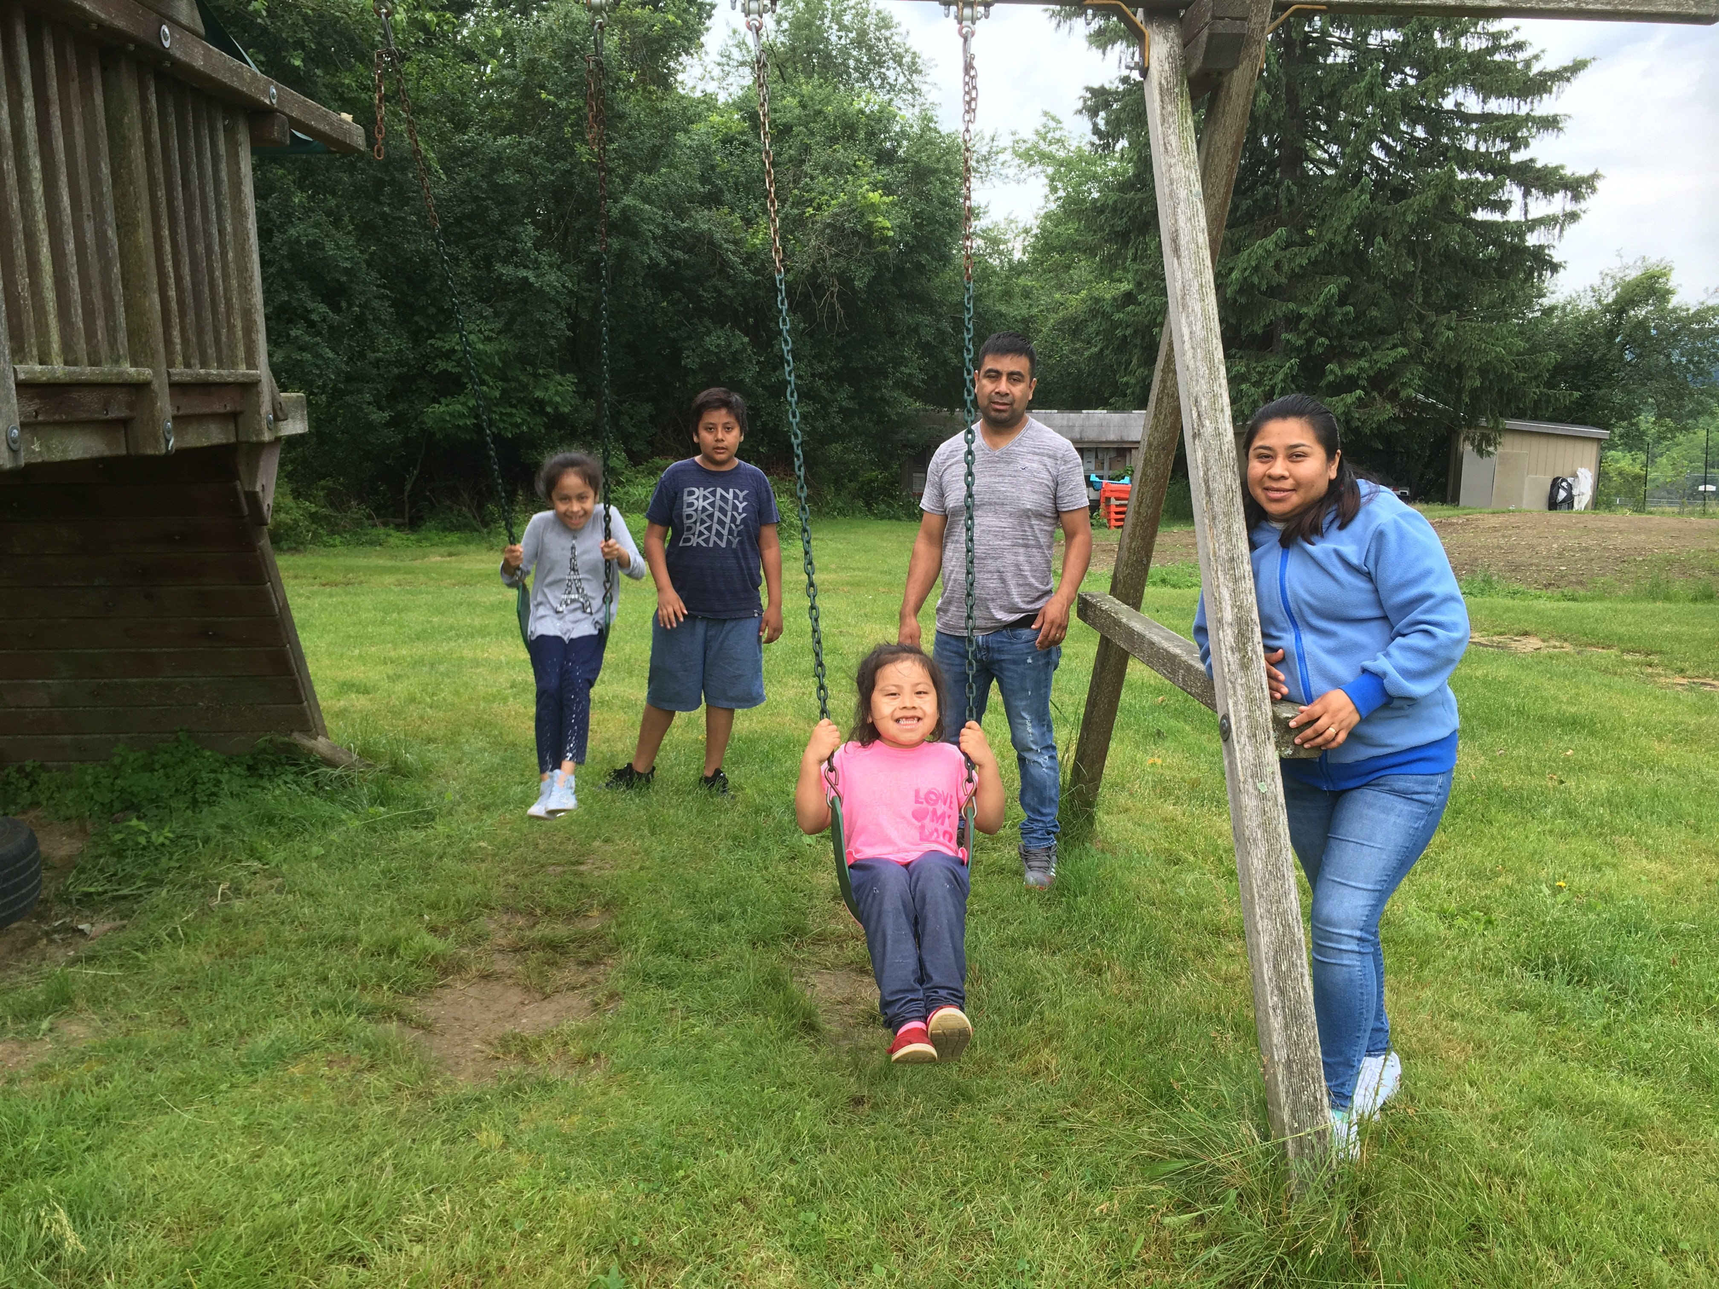
Familia Adelante/Family Forward Collaboration
Plan & Practice
The Larios Family
Synergy - Collaborators working together results in deeper and more effective resources and expertise available for families; much more than a referral arrangement
Flexibility – Changes in program design made in response to evolving needs of families; trial and error
Budget – Shared collaboration budget requires transparency, recognition of mutual goals, and agreed-upon expectations
Communication & Data – Regular team meetings and shared database result in shared knowledge of families’ needs and goals and better outcomes

Slide 10
Familia Adelante/Family Forward Collaboration
Results
Sustainability
In first 2 ½ years of operation:
78 families (147 adults & 179 children) enrolled
99% of families have at least one adult working; 1% enrolled in school full-time
University of PA preliminary research trends:
Improvement in adult well-being: general health, positive affect, everyday stress levels & hope levels
Children demonstrated improvements on future expectations and hope scales
Improvement in financial capability, increase in employment and number of hours worked
Very high retention rate, strong social ties and sense of community
December 2019 secured 3-year grant from William J. and Dorothy K. O’Neill Foundation
Grow additional foundation support
Participate in national efforts to promote Whole Family Approach

Slide 11
The shuttle provides transportation east - west in Gloucester County. This needed service gives riders, who do not have personal transportation, accessibility to employment, social services, health care, shopping, etc.
Pascale Sykes Foundation - Community change agent, program funder
United Way of Gloucester County – Lead, project oversight and coordinator, financial management
County of Gloucester - Department of Human Services, Department of Economic Development, Public Works Department / Planning Division, One-Stop Employment Services - Access to potential ridership, knowledge of workforce locations and opportunities, provide employment skills
South Jersey Transportation Authority – Drivers, routes, shuttle operations
Cross County Connection – Technical, materials, marketing and promotional support
Heart of South Jersey– Social service reference info, service call collection data, monthly multi-page newsletter for riders
NJ Transit – Provide match funding for shuttle service through the JARC program

Slide 12
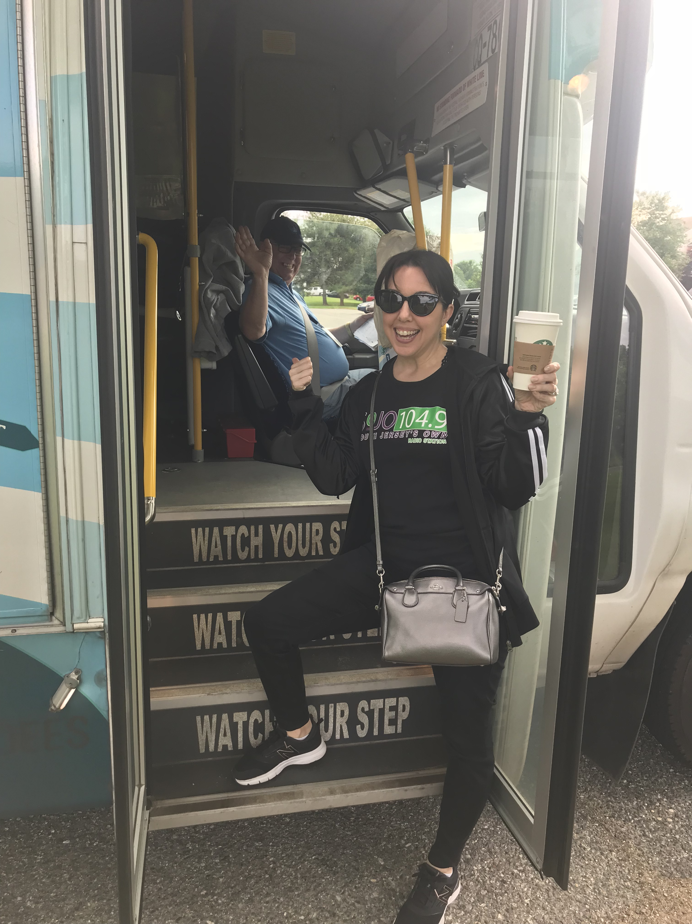
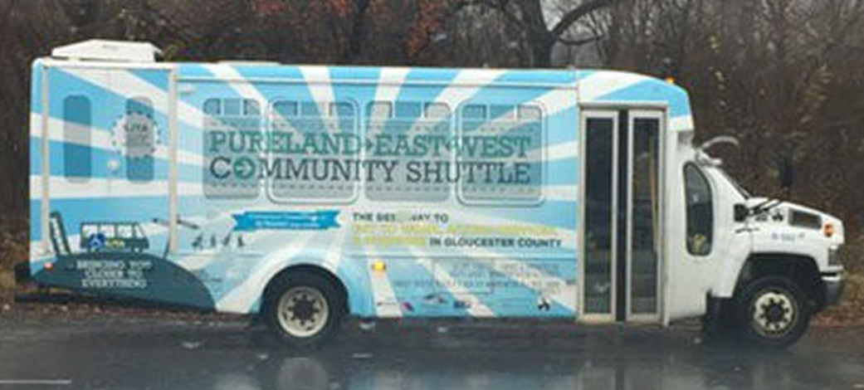
Pureland East-West Community Shuttle Program
Goals & Program
Plan & Practice
Improve access in South Jersey and the surrounding region
When we say access we mean:
Employment, job & career advancement opportunities
Educational programs and services
Retail (food, clothing, etc.)
Medical and Healthcare faculties
Services & Programs (nonprofits, libraries, government agencies, social services, etc.)
Access to regional transportation hubs
Find people who know the community, the clients and those current programs & services that are available.
Be quiet and listen – then share your knowledge and expertise.
Understand that the “team” that you need in the room will probably change over time.
Develop goals and make sure everyone is pulling the same way.
It’s not just about referrals, money or the assignment of duties. All of these things should be flexible to meet the needs of your clients.
Be open to change, let your clients guide you based on their feedback– you need them for your program to be a success!

Slide 13
Pureland East-West Community Shuttle
Results- Our riders now have:
Sustainability
Significant ridership boarding and exiting at the Pureland Industrial Complex (employment)
Riders have access to the monthly newsletter which spotlights social service programs and services that can benefit riders (printed copies on the shuttle)
Stops at the new Inspira Medical Center & Hospital (healthcare access)
Access to Rowan University and Glassboro area (education & retail)
Stop at a grocery store in Williamstown (access to basic needs)
Transfer agreement with NJ Transit to connect with 14+ major transit routes (regional access)
Daily and monthly ridership continues to grow – started with 500 riders month 1 to over 5,000 riders monthly
Riders tell us all the time that this service has changed their lives!
Find match for JARC Funding (currently Pascale Sykes Foundation)
Grow support for local, county and state government.
Engage with local businesses who’s employees and clients use the service.
Grow ridership to show the continued need for the service.

Slide 14
Lessons Learned, Best Practices
Make sure you have the right people around the table.
Make sure “all” partners are committed to the shared mission.
Partners and workgroup maybe, can and will change over time.
It’s okay not to be an expert on everything. That’s why you have a team. Don’t be afraid to ask questions.
Definition of roles is key; each partner organization should focus on their area of expertise.
Be flexible; continue doing what works but be willing to make changes as needed
Ongoing/ organized communication between partners is critical.
Results matter! Make sure you have a method in place to track your data.
Both outcomes and outputs are important.
So is quantitative and qualitative data.

Slide 15
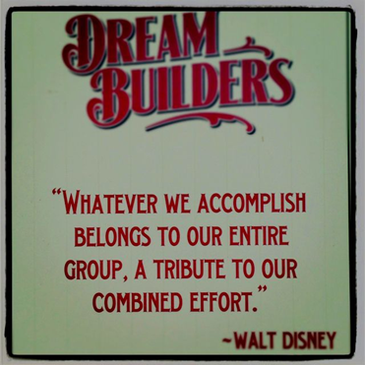
Questions? Comments?
Thank you for attending our breakout session.

